Slide 1






Big Data Modeling with R

Slide 2

About Me
Elijah Appiah from Ghana.
Ph.D. Economics at NIDA in Bangkok, Thailand.
Economist by profession and Data Scientist by passion.
Enthusiastic about working with data daily.
Technical skills in LATEX, Microsoft Office (Word, Excel, PowerPoint), SPSS, Stata, EViews, Python, R, MATLAB, Power BI, Tableau, and Google TensorFlow.

Slide 3
IDE and Packages for this Lecture
Main IDE for R is RStudio.
Packages:
benchmarkme
tidyverse
data.table
sparklyr
tidymodels
GGally
ggExtra

Slide 4
What is Big Data?
The three V’s of big data:
Volume: amount of data.
Variety: number of types of data.
Velocity: speed of data processing.
[Source: https://www.techtarget.com/whatis/definition/3Vs]

Slide 5
Why is Big Data Important?
Netflix: uses subscriptions and customers’ rating data for recommendation purposes.
Target: a big retailer in the US, uses data mining techniques to predict pregnancies of their shoppers, and send them a sale booklet for baby clothes, diapers, etc.
Car insurance companies analyze big data to understand how well their customers actually drive and how much to charge each customer to make a profit.
In education, student records, teacher observations, assessment results, and others.
New technologies such as facial recognition software and biometric signals, generate visual and audio data.

Slide 6
Analyzing Big Data - Steps
Read and extract the data.
Extract a subset, sample, or summary from the big data.
Repeat computation (e.g. fit a model) for many subgroups of the data.

Slide 7
Analyzing Big Data
You may need to store big data in a data warehouse (local database or cloud).
Then pass subsets of data from the warehouse to the local machine where the data are being analyzed.
What are the right tools for analyzing big data?

Slide 8
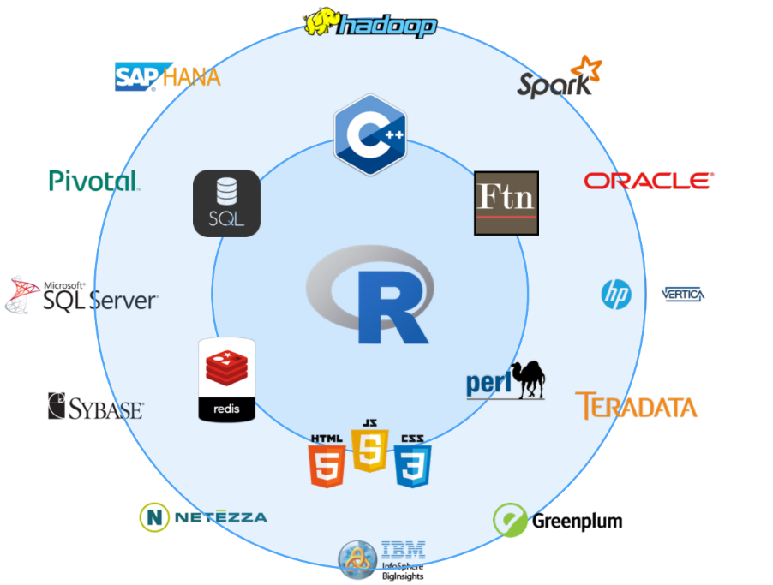
Analyzing Big Data

Slide 9
Analyzing Big Data
18 Best Open Source Tools for Big Data
https://www.datastackhub.com/top-tools/open-source-big-data-tools/

Slide 10
Analyzing Big Data – Suggestions
Obtain a strong computer (multiple and faster CPUs, more memory)
If memory is a problem, then access the data differently or split up the data.
Preview/visualize a subset of big data using a program, not the entire raw data.
Consider parallel computing and cloud computing.
Profile big tasks (in R) to cut down on computational time.

Slide 11

Now, let’s practice

Slide 12
Analyzing Big Data - Benchmarking
Assess the speed and performance of your system and compare the results with other systems.
benchmark_std() {benchmarkme}
benchmark_io() {benchmarkme}

Slide 13
Now, let’s practice

Slide 14
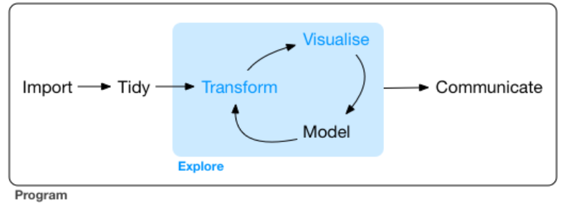
Analyzing Big Data – Exploratory Data Analysis (EDA)
Framework for data science:
Grolemund & Wickham (2017)

Slide 15
Analyzing Big Data – Data Wrangling with `data.table` Package
Data wrangling is a general term that refers to transforming data.
It involves subsetting, recoding, and transforming variables.
data.table {data.table}

Slide 16
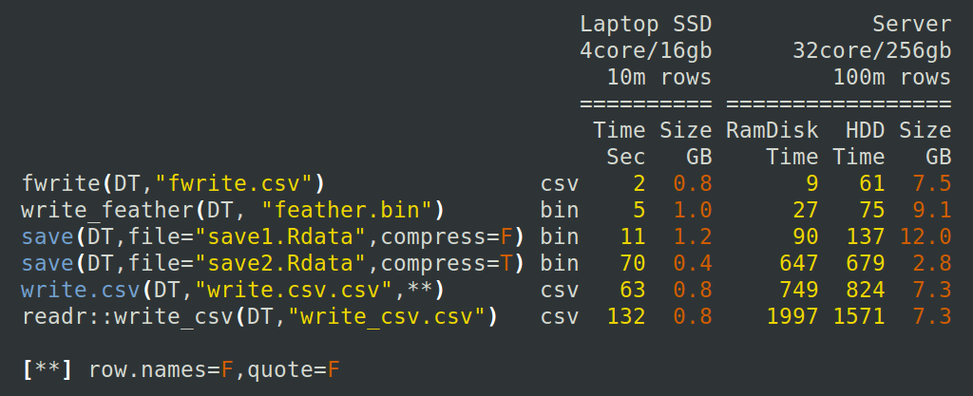
Analyzing Big Data
Source: https://tinyurl.com/y366kvfx

Slide 17
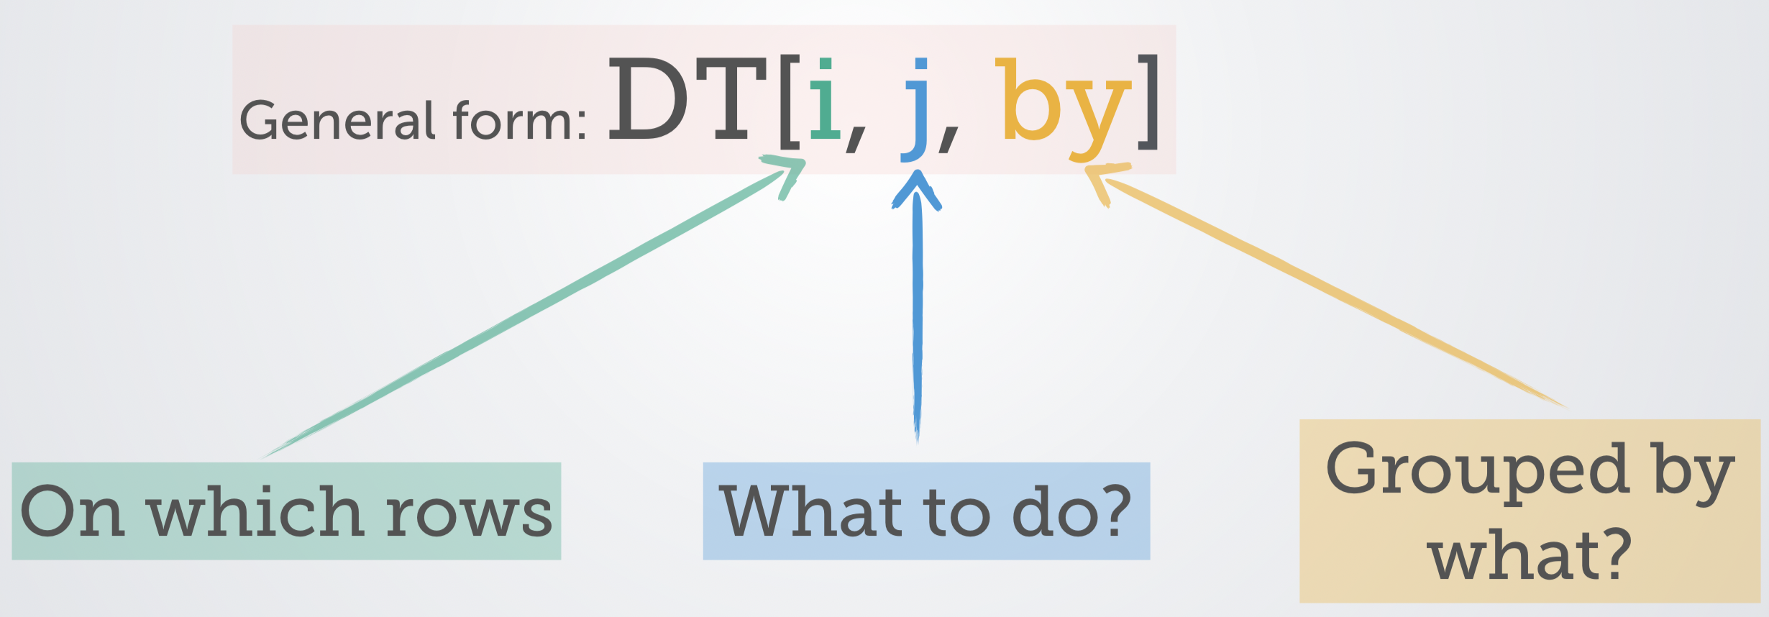
Analyzing Big Data – Data Wrangling with `data.table` Package
This is how data.table works on a dataframe:
Source: https://tinyurl.com/yyepwjpt

Slide 18
Now, let’s practice

Slide 19

Analyzing Big Data – The `sparklyr` Package
Spark is a cluster computing platform.
Data and computations spread across several machines.
Removes the limit to the size of your datasets.

Slide 20

Analyzing Big Data – The `sparklyr` Package
`sparklyr` is R’s package that helps you to access Spark.
You get R’s easy-to-write syntax plus Spark’s unlimited data handling – uses `dplyr` syntax.

Slide 21
Analyzing Big Data – The `sparklyr` Package
To use Apache Spark, install “Java 8 JDK”.
https://www.oracle.com/java/technologies/downloads/?er=221886#java8

Slide 22
Analyzing Big Data – The `sparklyr` Package
Install the package on R.
install.packages(“sparklyr”)
library(sparklyr)
Then run this code:
spark_install()
Connect-work-disconnect
Connect using spark_connect()
Work with it
Disconnect using spark_disconnect()

Slide 23

Analyzing Big Data – The `sparklyr` Package
The `dplyr` syntax
Select columns with select()
Filter rows with filter()
Arrange rows with arrange()
Change or add columns with mutate()
Calculate summaries using summarize()
Can be used with group_by() for grouped summaries.

Slide 24
Now, let’s practice

Slide 25
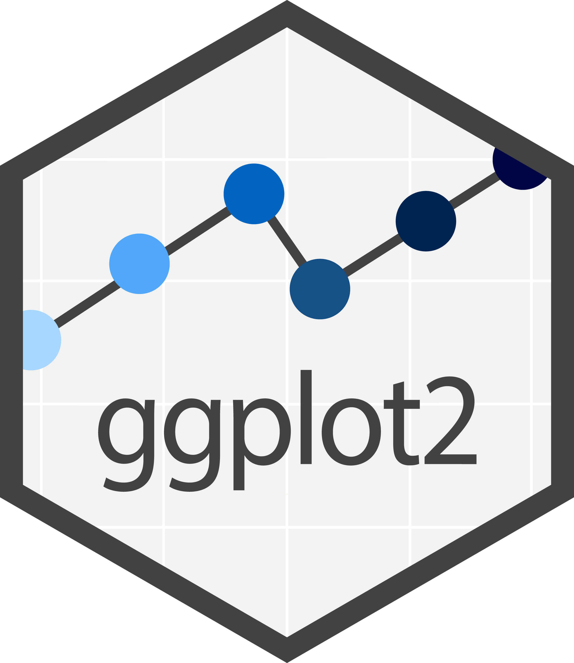
Visualizing Big Data – The `ggplot2` Package
7 Layers of `ggplot2` Package:
Data
Aesthetics
Geometries
Facets
Coordinates
Statistics
Themes

Slide 26
Visualizing Big Data – The `ggplot2` Package
Some plots include:
Marginal plots – distribution of individual variables in dataset.
Conditional plots – examine relationship between continuous variables.
Plots for examining correlations – scatterplot matrix, correlation matrix
Plots for ordinal/categorical variables – barplots, alluvium plots
Other packages to supplement our visualization
{Ggally}, {ggExtras}, {ggalluvial}

Slide 27
Now, let’s practice

Slide 28
Modeling Big Data – Machine Learning (ML)
Traditional modeling techniques can struggle to find information from big data.
Many turn to ML to generate insights from big data.
Machine learning (ML) is a field of study in artificial intelligence concerned with the development and study of statistical algorithms that can learn from data and generalize to unseen data, and thus perform tasks without explicit instructions.
Source: Wikipedia

Slide 29
Modeling Big Data – Machine Learning (ML)
Main Types of Machine Learning
Supervised ML: learn from labeled data. Algorithm is given both input and output variables called “training data” to learn patterns from the data, and make inferences on unseen data called “test data”.
Unsupervised ML: learn from unlabeled data. Algorithm is given only input data from which it identifies patterns on its own.

Slide 30
Machine Learning Algorithms
Supervised ML
Regression
Linear Regression
Support Vector Regression
Decision Tree Regression
Random Forest Regression
Classification
Logistic Regression
K-Nearest Neighbors (K-NN)
Support Vector Machine (SVM)
Naïve Bayes
Decision Tree Classification
Random Forest Classification
Unsupervised ML
Clustering
K-Means Clustering
Hierarchical Clustering
Anomaly Detection

Slide 31
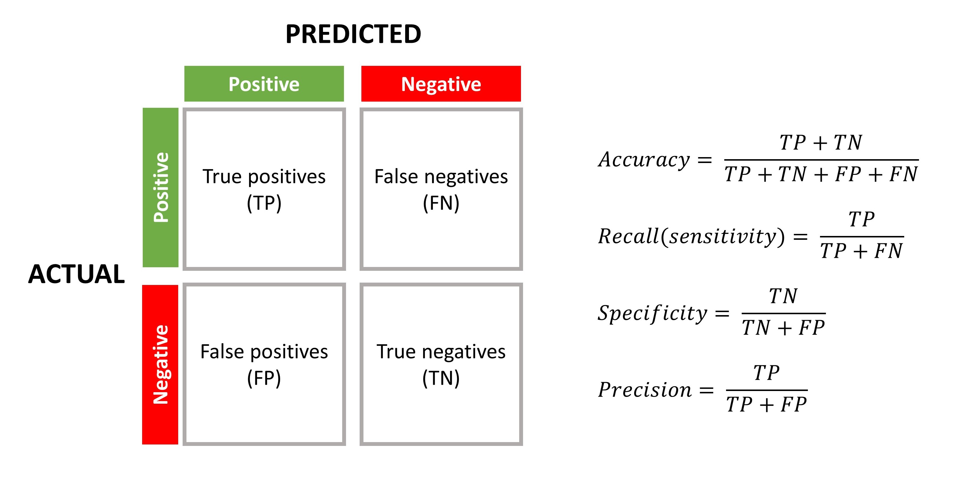
Model Evaluation - Classification
Confusion matrix: matrix counts of all combinations of actual and predicted outcomes.
Accuracy is used to calculate calculation ‘accuracy’.
Sensitivity is the proportion of all positive cases that were correctly classified.
Specificity is the proportion of all negative cases that were correctly classified.
False positive rate (FPR) is proportion of false positives among true negatives. (1-specificity).
Confusion Matrix for Classification Problems

Slide 32
Model Evaluation - Classification
Confusion Matrix for Classification Problems

Slide 33
Model Evaluation - Classification
Receiver Operating Characteristic (ROC) Curve is used to visualize model performance across probability thresholds.
Summary information of ROC curve is calculated using the ROC Area under the curve (ROC-AUC).

Slide 34
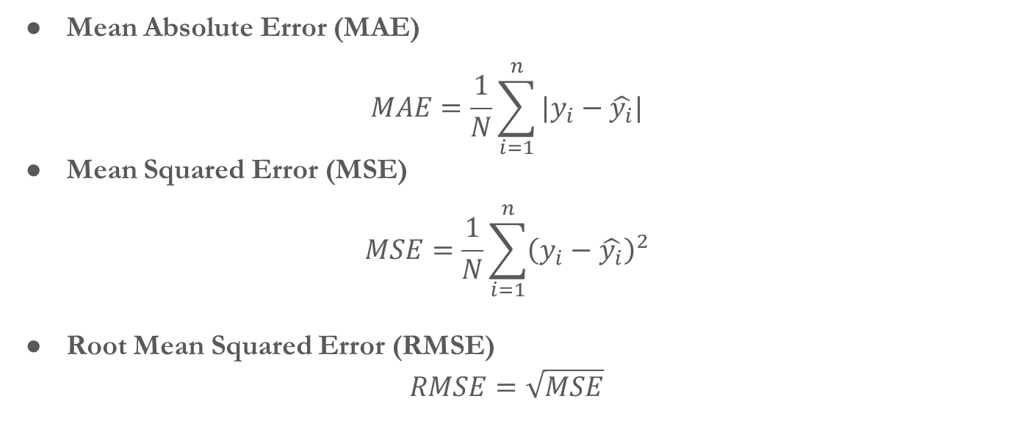
Model Evaluation – Regression
Mean Absolute Error (MAE)
$$MAE=\frac{1}{N}\sum_{i=1}^{n}{|y_{i}−\hat{y_{i}}|}$$
Mean Squared Error (MSE)
$$MSE=\frac{1}{N}\sum_{i=1}^{n}{{\left(y_{i}−\hat{y_{i}}\right)}^{2}}$$
Root Mean Squared Error (RMSE)
$$RMSE=\sqrt{MSE}$$

Slide 35
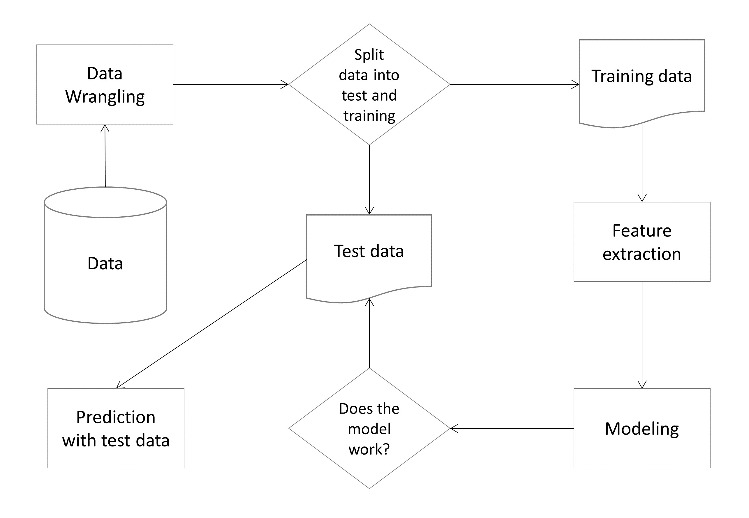
Typical Machine Learning Pipeline

Slide 36
Key Issues in ML
Generalization is how well a ML model can apply to the test data.
Overfitting
A model that performs too well on the training data but poorly on the test data.
Underfitting
A model that does not learn well on the training data, and does not generalize well on the test data.
Both overfitting and underfitting may cause poor performance of ML algorithms.
Some Remedies:
Resampling technique or cross-validation
Validation dataset

Slide 37
Modeling Big Data – Machine Learning (ML)
Main Package for ML in R:
tidymodels

Slide 38
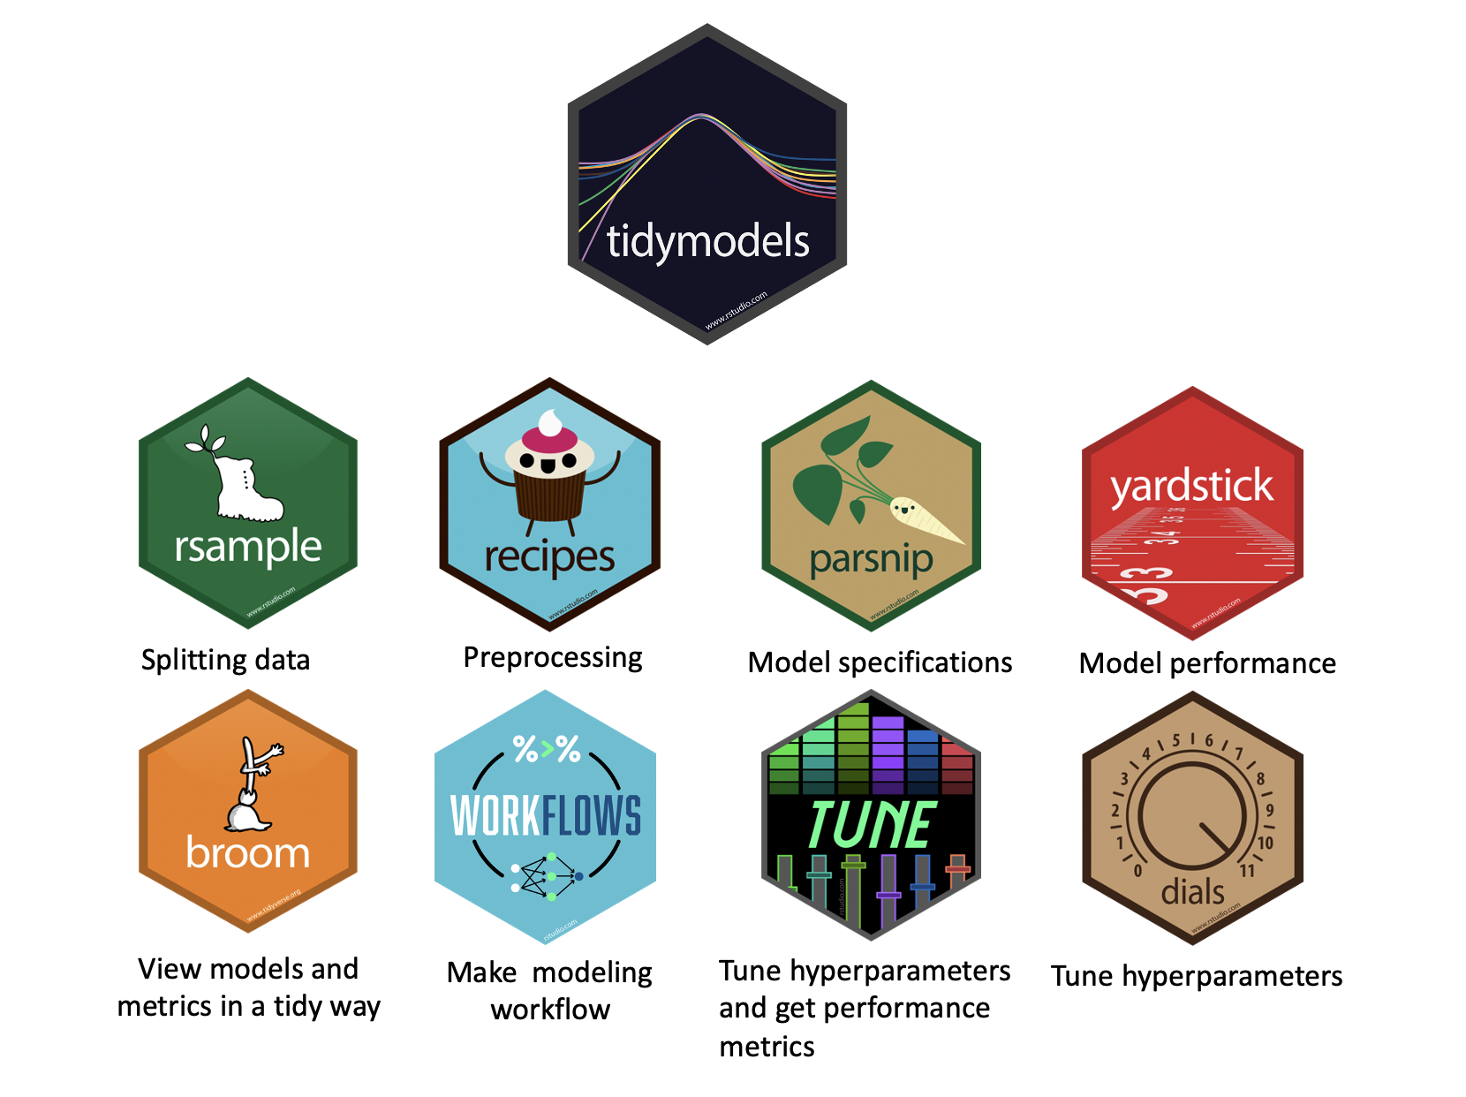

Slide 39
Big Data Modeling – Project Time
TIME FOR A PROJECT!

Slide 40
Now, let’s practice

Slide 41
THANK
YOU

